Slide 1
Using SQL Server Denali's Always On (HADR)
Denny Cherry
mrdenny@mrdenny.com
twitter.com/mrdenny

Slide 2

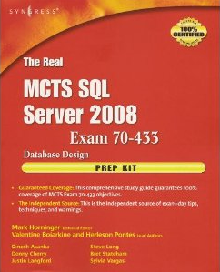



About Me
Author or Coauthor of 4 books
6+ SQL Mag articles
Dozens of other articles
Microsoft MVP since Oct 2008
Microsoft Certified Master
Founder of SQL Excursions
Sr. DBA for Phreesia

Slide 3
What is “Always On”?
AKA “HADR”
Combines Best of Mirroring and Clustering
Can allow for backups to be read

Slide 4

What Parts of Clustering?
Uses the clustering APIs for failover
No cluster IPs or shared storage, users still connect to normal instance
Shared IP Address for central connection point

Slide 5
What Parts of Mirroring?
Uses Mirroring for the data transport
Uses Mirroring TCP Endpoint

Slide 6
New Terms to Know
Availability Groups
Availability Replicas
Availability Databases

Slide 7
Setup Requirements
All Instances must be installed on Windows 2008 R2 Enterprise (or higher)
All servers running as part of HADR much be in a single Windows cluster
SQL is not clustered
Databases must be in full recovery

Slide 8
Setup Notes
Multiple Databases in a single Availability Group
IO profiles on primary and secondary are different
  Primary only writes on checkpoint
  Secondary writes as changes are received
  (The same as Legacy DB Mirroring)
All compatibility modes are supported
No Shared Storage
Matching hardware is not required

Slide 9

Data Transfer
Data is transferred via Data Mirroring Endpoint
Endpoints created via the Wizard automatically if not created

Slide 10
Configuration Options…
Management Studio
  Wizard Driven Setup
PowerShell
  CmdLets on the next slide
T/SQL
  CREATE AVAILABILITY GROUP – Setup Primary
  ALTER AVAILABILITY GROUP – Join Secondary

Slide 11


PowerShell CmdLets
  Setup
    New-SqlAvailabilityGroup
    New-SqlAvailabilityReplica
    Add-SqlAvailabilityGroupDatabase
    Join-SqlAvailabilityGroup
  Breakdown
    Remove-SqlAvailabilityGroup
    Remove-SqlAvailabilityGroupDatabase
  Management
    Suspend-SqlAvailabilityGroup
    Switch-SqlAvailabilityGroup

Slide 12

Sample PowerShell Script to Configure HADR
# Setup names and TCP addresses of the primary and secondary servers.
$primaryServerName = "[PrimaryServerName]";
$secondaryServerName = "[SecondaryServerName]";
$primaryEndpointUrl = "TCP://" + $primaryServerName + ".web_domain:5022";
$secondaryEndpointUrl = "TCP://" + $secondaryServerName + ".web_domain:5022";
# Next create the Availability Replicas as templates.
$replica1 = new-sqlavailabilityreplica -Name $primaryServerName -EndpointUrl $primaryEndpointUrl -AsTemplate
$replica2 = new-sqlavailabilityreplica -Name $secondaryServerName -EndpointUrl $secondaryEndpointUrl -AsTemplate
# Finally create the Availability Group.
$ag = new-sqlavailabilitygroup -Name $availabilityGroupName -AvailabilityReplica ($replica1, $replica2) -Database $databases
#Tells a secondary Server to join the Availability Group
Join-SqlAvailabilityGroup -Path . -Name "My Availability Group"
Sorry About the Eye Chart
Sorry About the Eye Chart

Slide 13
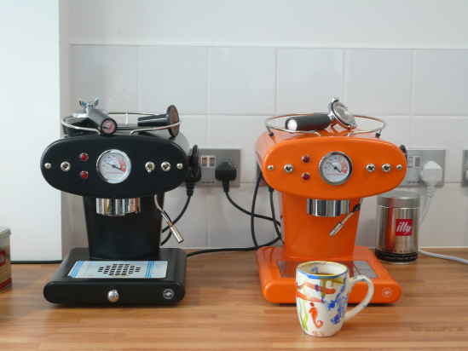
Failing over HADR
Done via SSMS.
Switch-SqlAvailabilityGroup PowerShell CmdLet
ALTER AVAILABILITY GROUP test FORCE_FAILOVER_ALLOW_DATA_LOSS;
  Which allows for data loss, and doesn’t appear to have a graceful failover option
http://www.flickr.com/photos/criminalintent/2569906181/

Slide 14
Known Bugs Features in CTP1
Failover requires data loss
Only 2 Replica Servers are supported in CTP1
Failover in SSMS sucks.
Testing the network share fails for no reason
There is no Get-SqlAvailabilityGroup, use get-item instead.

Slide 15
Known Bugs Features in CTP1
No way to add databases or replicas via SSMS
No way to tell in Object Explorer if a database is an HADR database
SELECT INTO doesn’t work correctly

Slide 16
What can we use HADR for?
Getting a backup of the database on a remote machine
Taking a snapshot of a database
Offloading CheckDB from production server
Offloading reporting from production server
Redundancy - Dugh

Slide 17

What’s known to be coming?
Support for up to 4 secondary servers
  Up to 2 Synchronous
  Up to 4 Asynchronous
Backups on the secondary servers
The ability to fail over without data loss
Automatic Failover

Slide 18
What’s Still Unknown
Licensing of passive nodes
Licensing of read only nodes
Edition Requirements to use HADR

Slide 19

Lets see how we set this thing up

Slide 20
Denny Cherry
mrdenny@mrdenny.com
http://itke.techtarget.com/sql-server
http://twitter.com/mrdenny
Please fill out the survey at http://speakerrate.com/mrdenny.

